Slide 1


Slide 2
This is Havering
2018
A Demographic and
Socio-economic profile
Some Key Facts and Figures
Version 4.1
(August 2018)
By London Borough of Havering
Public Health Service

Slide 3
Background
This is Havering… …is a Joint Strategic Needs Assessment (JSNA) product that provides a snapshot of the demographic and socio-economic profile of Havering …is intended to be the “one version of the truth” in relation to the demographic and socio-economic profile of Havering
Produced by Public Health Intelligence

Slide 4
Approach
A snapshot – concise and limited document size Readable and less technical Good visualisation of data, where appropriate Updatable with new data, with less difficulty (biannualy updates currently agreed)¹ Useful to commissioners and other stakeholders See the main document (“This is Havering: a demographic and socioeconomic profile”) at https://www.haveringdata.net/joint-strategic-needs-assessment/ Note: This PowerPoint version does not contain all the information in the main document
¹ The next update is due in January 2018
Produced by Public Health Intelligence

Slide 5
Contents
GEOGRAPHIC PROFILE
POPULATION PROFILE
HOUSEHOLD PROFILE
ECONOMIC PROFILE
- Geographical location - Havering as a place - Deprivation
- Size and structure - Population change - Ward level change - Births and migration - Projected change - Life expectancy - Ethnicity - Disabilities
- Household size - Mosaic groups - Housing tenure - Housing conditions - Homelessness - Short term migrants - Traveller population - Social isolation
Income Car ownership - Child poverty - Employment and unemployment
Produced by Public Health Intelligence

Slide 6
GEOGRAPHIC
PROFILE
POPULATION
PROFILE
HOUSEHOLD
PROFILE
ECONOMIC
PROFILE
- Geographical location - Havering as a place - Deprivation
- Size and structure - Population change - Ward level change - Births and migration - Projected change - Life expectancy - Ethnicity - Disabilities
- Household size - Mosaic groups - Housing tenure - Housing conditions - Homelessness - Short term migrants - Traveller population - Social isolation
- Income - Car ownership - Child poverty - Employment and unemployment
Produced by Public Health Intelligence

Slide 7
Geographic – Summary
The London Borough of Havering is the 3rd largest borough in London (43 miles²) and has 18 electoral wards. It is mainly characterised by suburban development, with almost half of the area dedicated to open green space, particularly to the east of the borough. Principal town (Romford) is densely populated and is an area of major metropolitan retail and night time entertainment. The southern part of Havering is within the London Riverside section of the Thames Gateway redevelopment area and will be an area of increasing development and population change. A relatively affluent borough but pockets of deprivation to the north (Gooshays and Heaton wards) and south (South Hornchurch)
Produced by Public Health Intelligence

Slide 8
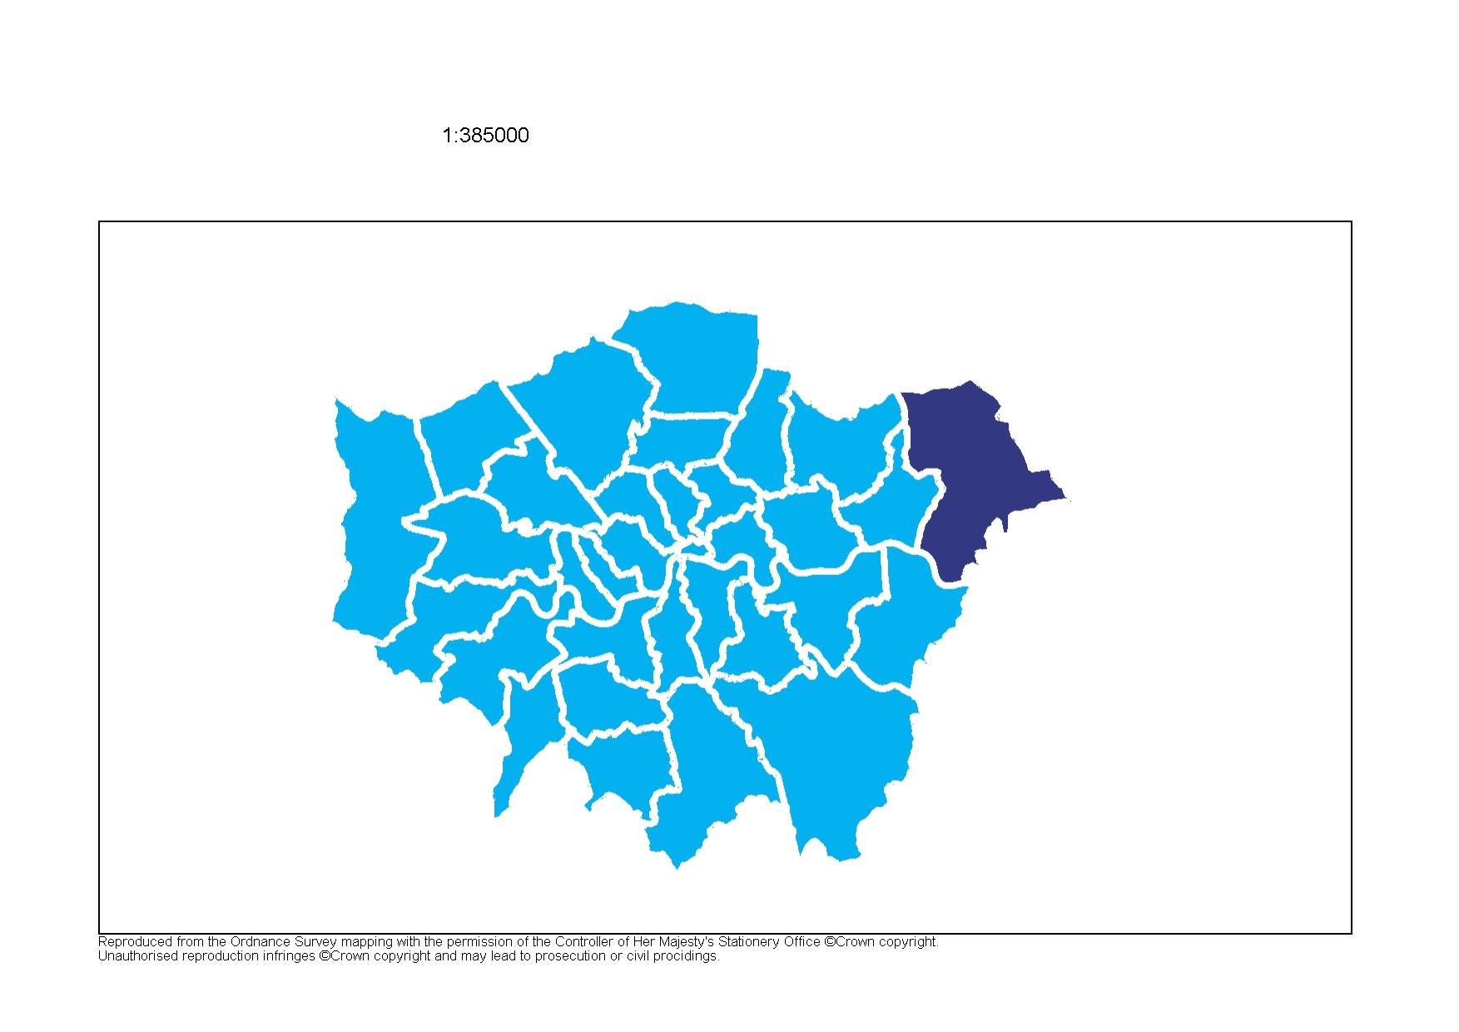
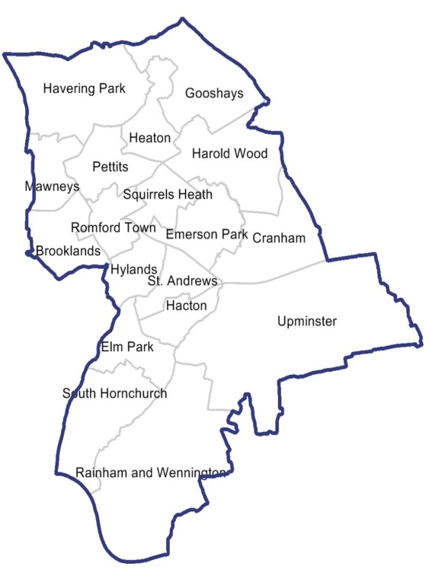
Geographic – Location
Havering is located on the northeast boundary of Greater London
18 Electoral Wards 3rd largest borough in Greater London (43 miles²)
Produced by Public Health Intelligence

Slide 9
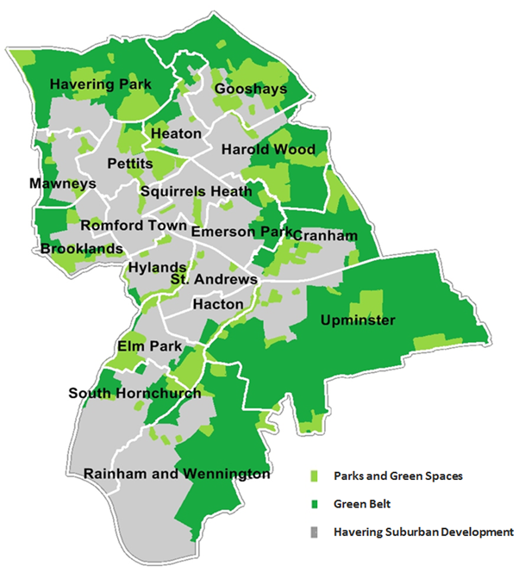
Geographic - Green Spaces
Havering is mainly characterised by suburban development, with almost half of the borough dedicated to open green space.
Dataset: Local Land and Property Gazetteer
Data Source: National Land and Property Gazetteer
Produced by Public Health Intelligence

Slide 10
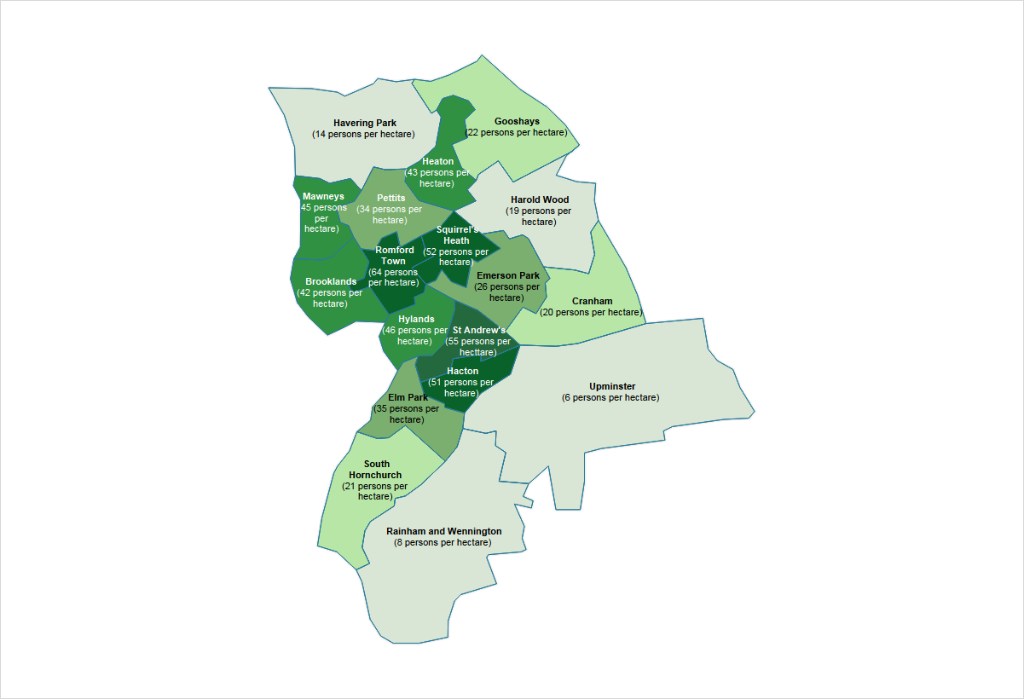
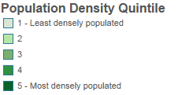
Geographic
– Population Density
The principal town (Romford) is densely populated and is an area of major metropolitan retail and night time entertainment.
The southern part of Havering is a part of a section of the Thames Gateway redevelopment area.
Dataset: Mid-year Population Estimates 2017 and UK Standard Area of Measurements
Data Source: Office for National Statistics (ONS)
Produced by Public Health Intelligence

Slide 11
Geography – Deprivation
There are pockets of deprivation to the north (Gooshays and Heaton wards) and south (South Hornchurch) of the borough.
Most Deprived
More Deprived
Deprived
Less Deprived
Least Deprived
Deprivation quintile score of Havering LSOAs* relative to Havering
Deprivation quintile score of Havering LSOAs* relative to England
*LSOA – Lower Super Output Area
Dataset: Indices of Multiple Deprivation, 2015
Data Source: Department for Communities and Local Government
Produced by Public Health Intelligence

Slide 12
GEOGRAPHIC
PROFILE
POPULATION
PROFILE
HOUSEHOLD
PROFILE
ECONOMIC
PROFILE
- Geographical location - Havering as a place - Deprivation
- Size and structure - Population change - Ward level change - Births and migration - Projected change - Life expectancy - Ethnicity - Disabilities
- Household size - Mosaic groups - Housing tenure - Housing conditions - Homelessness - Short term migrants - Traveller population - Social isolation
- Income - Car ownership - Child poverty - Employment and unemployment
Produced by Public Health Intelligence

Slide 13
Population – Summary (I)
The estimated population of Havering is 256,039 It has the oldest population in London (median age is approximately 40 years) Havering experienced a net population loss of 6.3% from 1983 to 2002, the population of Havering has increased year on year from 2002, with a 13.7% increase from 2002 to 2017 There is increase in general fertility rate: 58 births (per 1,000 women aged 15-44) in 2004 to 68 in 2017 – an additional 10 births per 1,000 women aged 15-44 Havering experienced largest net inflow of children across all London boroughs (4,580 children) in a 6-year period (2011-2016) Largest increases in population will occur in children (0-17 years) and older people age groups (65 years and above) up to 2033
Produced by Public Health Intelligence

Slide 14
Population – Summary (II)
Life expectancy at birth is 80.1 years for males and 84.2 years for females. Life expectancy at 65 years is 18.9 years for males and 21.7 years for females On 2011 census day, 83% of residents were recorded as White British - higher than both London and England About 90% of the borough population were born in the United Kingdom An increase in the Black African population is projected from 4.1% in 2017 to 5.3% of the Havering population in 2032 19% of working age people in Havering disclosed that they have a disability or long term illness
Produced by Public Health Intelligence

Slide 15
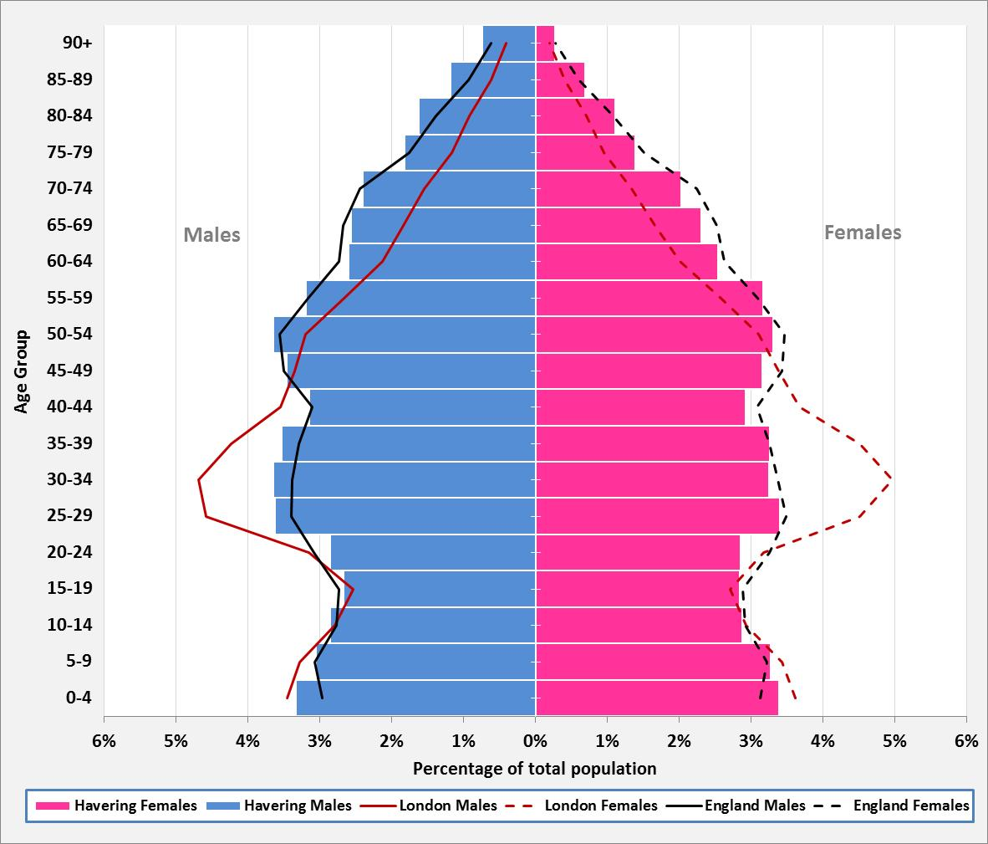
Population – Age Structure
Population of Havering is 256,039
Havering has the oldest population in London with a median age of 40 years old
Age structure is similar to England but older than London.
Dataset: Mid-year Population Estimates 2017
Data Source: Office for National Statistics (ONS)
Produced by Public Health Intelligence

Slide 16
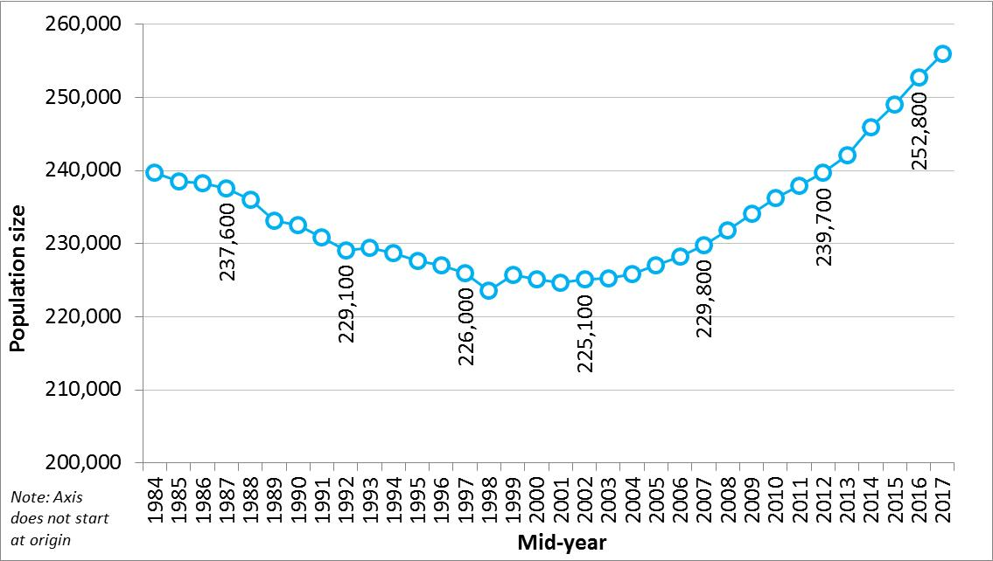
Population - Trend
Net population loss of 6.3% from 1983 (240,200) to 2002 (225,100) but the population of Havering has increased year on year from 2002, with a 13.7% increase from 2002 to 2017
Dataset: Mid-year population estimates 1983-2016 (nearest hundreds)
Data Source: Office for National Statistics (ONS)
Produced by Public Health Intelligence

Slide 17
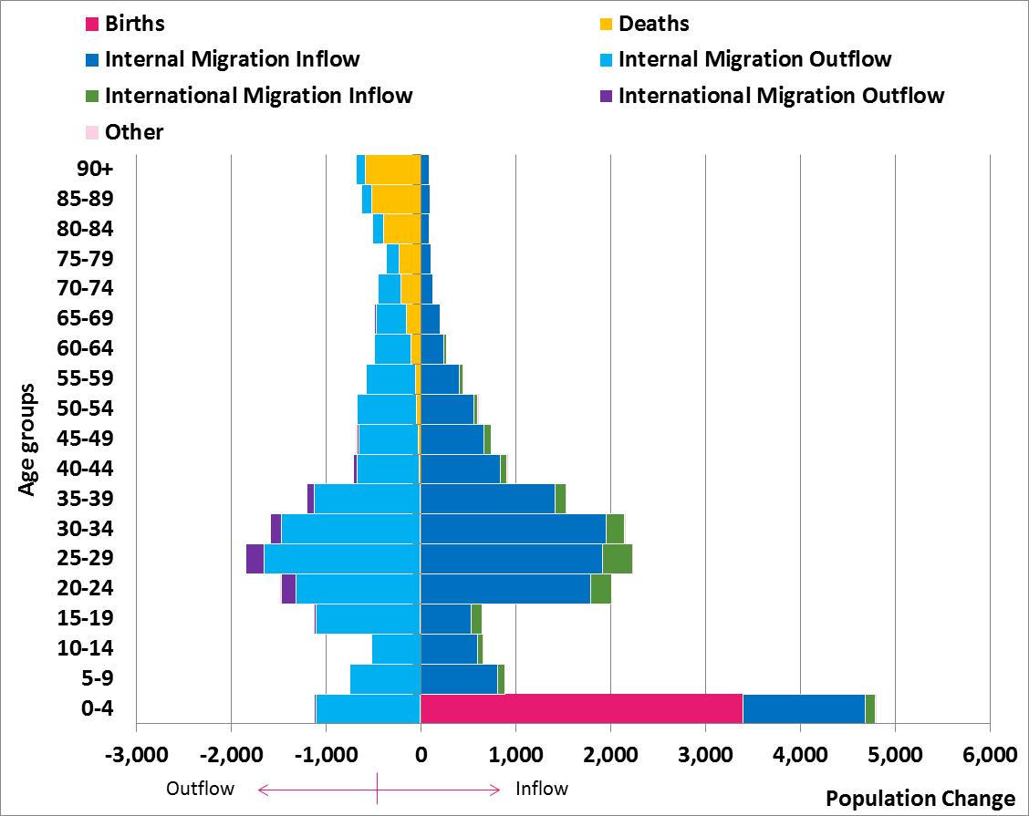
Population
– Changes (2017)
Children aged 0-4 years are the largest contributors to population change, largely due to births.
A net decrease in adults aged 75+ largely due to deaths.
Dataset: Mid-year population estimates 2017 Analysis Tool Data Source: Office for National Statistics (ONS)
Produced by Public Health Intelligence

Slide 18
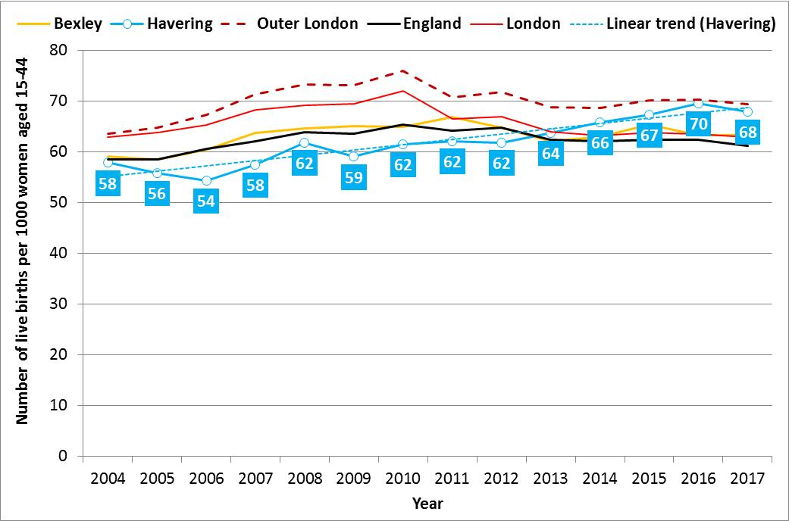
Population – Change (Births)
Increase in general fertility rate (per 1,000 women aged 15-44) from 58 births in 2004 to 68 in 2017 - an additional 10 births per 1,000 women aged 15-44
Dataset: Live Births, General Fertility Rates and Total Fertility Rates, 2004-2016 Data Source: Office for National Statistics (ONS)
Produced by Public Health Intelligence

Slide 19
Population
– Change (Inflow)
Between 2011 and 2016, 4,580 children settled in Havering from another London borough - the largest net inflow of children across all London boroughs during the six year period
Dataset: Internal Migration Flows, 2011-2016
Data Source: Greater London Authority (GLA)
Produced by Public Health Intelligence

Slide 20
Population – Ward Projections
The populations in Romford Town, Brooklands and South Hornchurch wards are expected to increase the most over the next fifteen years.
Dataset: 2016 Round Strategic Housing Land Availability Assessment (SHLAA)-Based Projections Data Source: Greater London Authority (GLA)
Produced by Public Health Intelligence

Slide 21
Population – Projections
The population is projected to increase from 257,514 (in 2018) by 7%, 14% and 18% to 276,645 (in 2023), 294,665 (in 2028) and 303,769 (in 2033) respectively.
The largest increases will occur in children (0-17 years) and older people (65 years and above) up to 2033.
Dataset: 2016 Round Strategic Housing Land Availability Assessment (SHLAA)-Based Projections Data Source: Greater London Authority (GLA)
Produced by Public Health Intelligence

Slide 22
Population – Life Expectancy at Birth
The life expectancy at birth for people living in Havering is 79.6 years for males and 84.2 years for females
Life expectancy in Havering has been mostly higher than the England average and has been on the increase over the last decade
Dataset: Life expectancy at birth, 2001-2003 to 2015-2017
Data Source: Office for National Statistics (ONS)
Produced by Public Health Intelligence

Slide 23


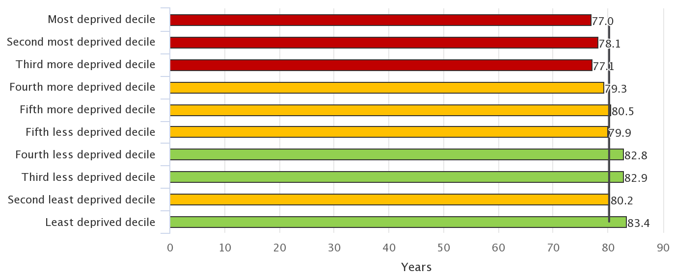
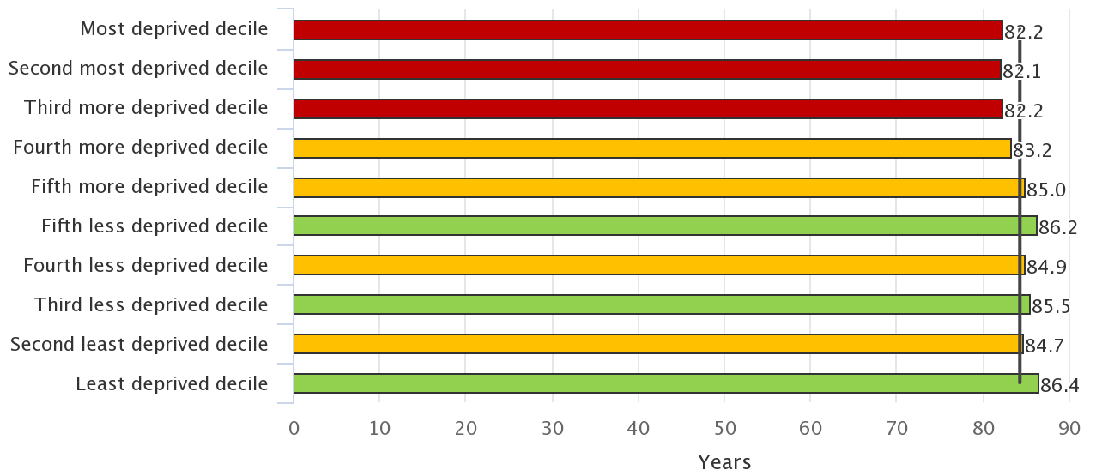
Population – Life Expectancy at Birth (Inequalities)
Gap in life expectancy at birth between most and least deprived decile within Havering is 6.4 years for males and 4.2 years for females
0.1ii. Life expectancy at birth – Male
0.1ii. Life expectancy at birth – Female
Dataset: Public Health Outcomes Framework (PHOF - 0.1ii. Life expectancy at birth, 2014-16)
Data Source: Public Health England (PHE)
Produced by Public Health Intelligence

Slide 24
Population – Life Expectancy at 65
The life expectancy at 65 years for people living in Havering is 18.5 years for males and 21.6 years for females
Mostly higher than the England average for females in last decade. And has been on the increase over the last decade (for both males and females).
Dataset: Life expectancy at 65, 2001-2003 to 2015-2017
Data Source: Public Health Outcomes Framework (PHOF)
Produced by Public Health Intelligence

Slide 25
Population – Ethnicity
Havering is one of the most ethnically homogenous places in London, with 83% of its residents recorded as White British higher than both London and England
Dataset: Census, 2011
Data Source: Office for National Statistics (ONS)
Produced by Public Health Intelligence

Slide 26
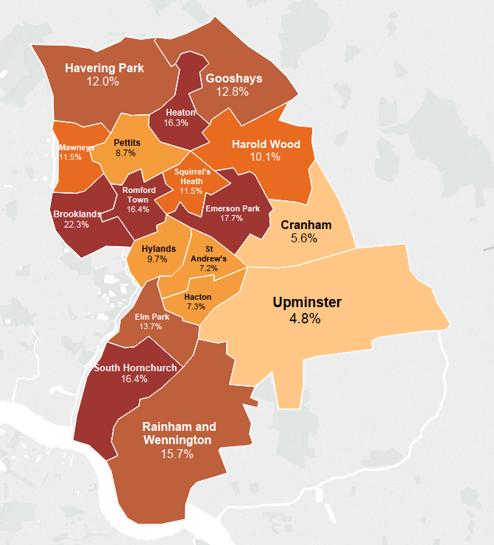
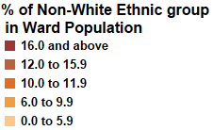
Population
– Ethnicity by Ward
Brooklands, Emerson Park, Romford Town and South Hornchurch are the wards with the highest proportion of non-white categories.
Dataset: Census, 2011
Data Source: Office for National Statistics (ONS)
Produced by Public Health Intelligence

Slide 27
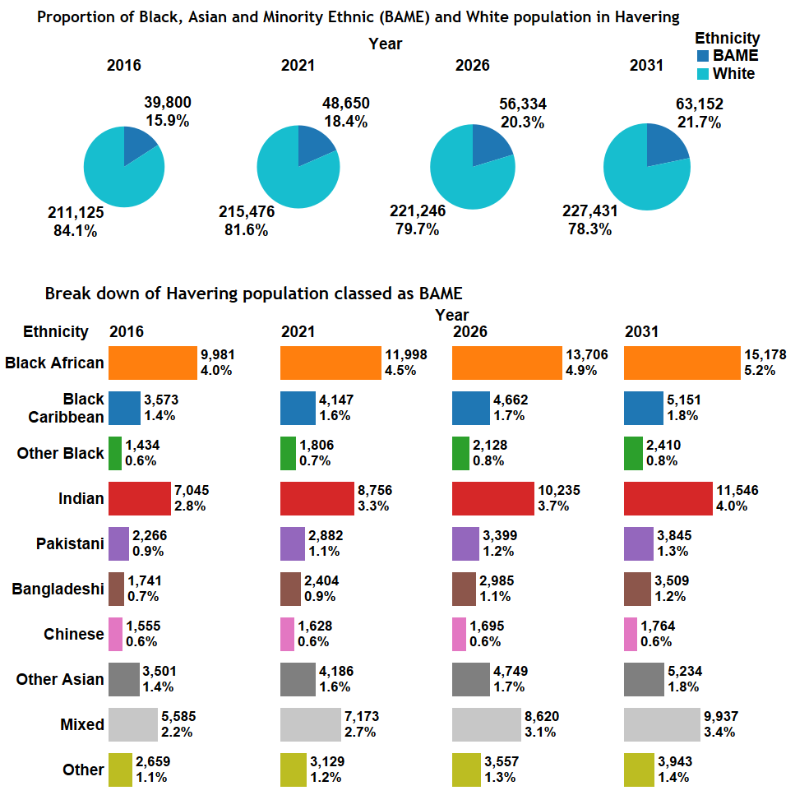
Population – Ethnicity Projections
The white population (including the minority white population) is projected to decrease from 84% (in 2016) to 78% (in 2031) of the population
It is projected that the Black African population will increase from 4% in 2016 to 5.2% of the Havering population in 2031.
Dataset: GLA 2015 Round Trend-based ethnic group projections, long-term migration scenario; Data Source: Greater London Authority (GLA)
Produced by Public Health Intelligence

Slide 28
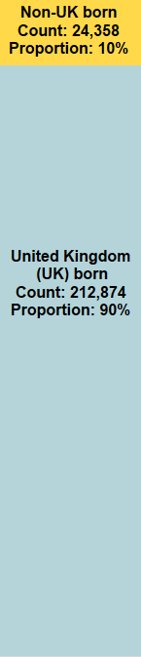
Population – Country of Birth
90% of Havering residents were born in the UK
Country of birth of non-UK born residents
Count (rate per 10,000 of Havering population)
Dataset: Census, 2011
Data Source: Office for National Statistics (ONS)
Produced by Public Health Intelligence

Slide 29
Population – Disability
Havering is estimated to have one of the highest rates of serious physical disabilities among London boroughs.
Dataset: Health Survey for England, 2001
Data Source: Projecting Adult Needs and Service Information (PANSI 2017)
Produced by Public Health Intelligence

Slide 30
GEOGRAPHIC
PROFILE
POPULATION
PROFILE
HOUSEHOLD
PROFILE
ECONOMIC
PROFILE
- Geographical location - Havering as a place - Deprivation
- Size and structure - Population change - Ward level change - Births and migration - Projected change - Life expectancy - Ethnicity - Disabilities
- Household size - Mosaic groups - Housing tenure - Housing conditions - Homelessness - Short term migrants - Traveller population - Social isolation
- Income - Car ownership - Child poverty - Employment and unemployment

Slide 31
Household – Summary (I)
There are 105,691 households in Havering Households are mainly composed of pensioners and married couples with dependent children All adults in 52% of households (40,722) are working and no adults are working in 16% of households (12,256) In 2011, there were 7,224 one-adult households with children under 16 in Havering. This is an increase from 2001 when there were 4,005 lone parent households. 73% of the population in Havering are home owners – one of the highest proportions across London boroughs Housing is mainly Victorian and Edwardian. Houses are generally large with an average of 2.8 bedrooms per household (higher than both London and England)
Produced by Public Health Intelligence

Slide 32
Household – Summary (II)
Rate of homeless households in temporary accommodation is 7.2 per 1,000 households (lower London but higher than England). Rate of statutory homelessness (eligible people not in priority need) is 0.5 per 1,000 households (higher than both London and England). The borough has a rate of short-term international migrants of 165 per 100,000 population, the second lowest of all London local authorities. 99% of the traveller caravans in Havering were on authorised sites, as at January 2018. 32% (13,449) of the population aged 65 years and above are living in one-person households. Almost half (48%) of all one person households in Havering are occupied by persons aged 65 years and over, which is the highest proportion in London
Produced by Public Health Intelligence

Slide 33
Household – Size and Composition
In 2011, there were 7,224 one-adult households with children under 16 – an increase from 4,005 a decade earlier. There has also been an increase in the number of one-adult households with no children.
Dataset: For 1981,1991,and 2001 - Historic Census Tables; For 2011 - Census 2011 Table KS105EW
Data Source: Greater London Authority and adapted from the Office of National Statistics (ONS)
Produced by Public Health Intelligence

Slide 34
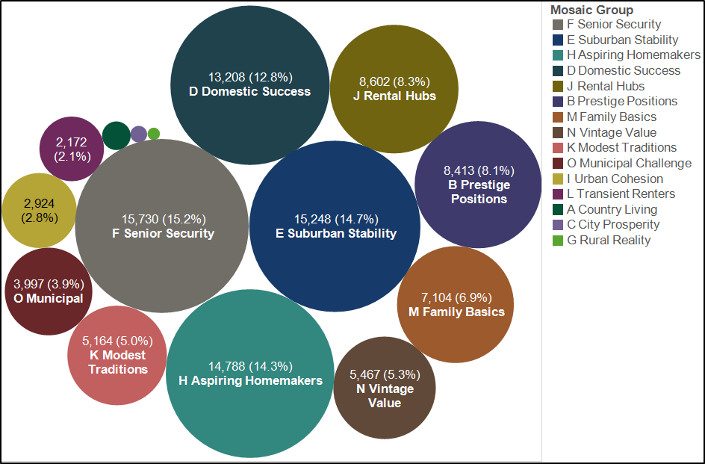
Household – Mosaic Groups
The top five Mosaic groups account for 65% of the households in Havering
Dataset: Mosaic Public Sector, 2017
Data Source: Experian
Produced by Public Health Intelligence

Slide 35
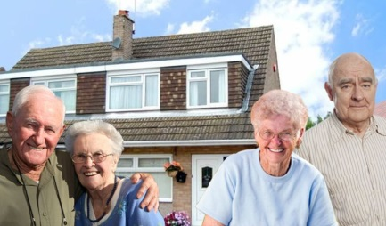
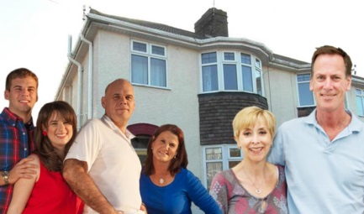
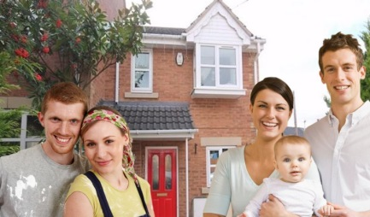
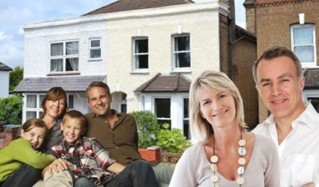
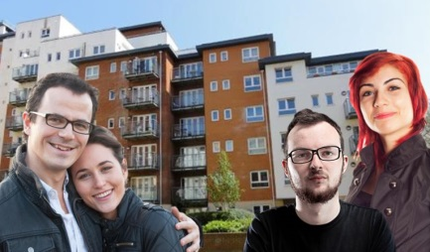
Household – Top 5 Mosaic Groups
Group – Name | Typical Profile Picture | One Line Description | Key Features
F – Senior Security |  | Elderly people with assets who are enjoying a comfortable retirement | Elderly singles and couples Homeowners Comfortable homes Additional pensions above state Don't like new technology Low mileage drivers
E – Suburban Stability |  | Mature suburban owners living settled lives in mid-range housing | Older families Some adult children at home Suburban mid-range homes 3 bedrooms Have lived at same address some years Research on Internet
H – Aspiring Homemakers |  | Younger households settling down in housing priced within their means | Younger households Full-time employment Private suburbs Affordable housing costs Starter salaries Buy and sell on eBay
D – Domestic Success |  | Thriving families who are busy bringing up children and following careers | Families with children Upmarket suburban homes Owned with a mortgage 3 or 4 bedrooms High Internet use Own new technology
J – Rental Hubs |  | Educated young people privately renting in urban neighbourhoods | Aged 18-35 Private renting Singles and sharers Urban locations Young neighbourhoods High use of smartphones
Dataset: Mosaic Public Sector, 2017
Data Source: Experian
Produced by Public Health Intelligence

Slide 36
Household – Tenure
73% of the population in Havering are home owners. This is one of the highest proportions across London boroughs
Dataset: Integrated Household Survey, 2015
Data Source: Office for National Statistics (ONS)
Produced by Public Health Intelligence

Slide 37
Household – Homelessness
Rate of homeless households in temporary accommodation in Havering is 8.9 per 1,000, lower than London but higher than England
Also in the highest quartile when compared to other across other local authorities in similar deprivation decile (3rd less deprived)
Dataset: Public Health Outcomes Framework (1.15ii), 2017-18
Data Source: Public Health England
Produced by Public Health Intelligence

Slide 38
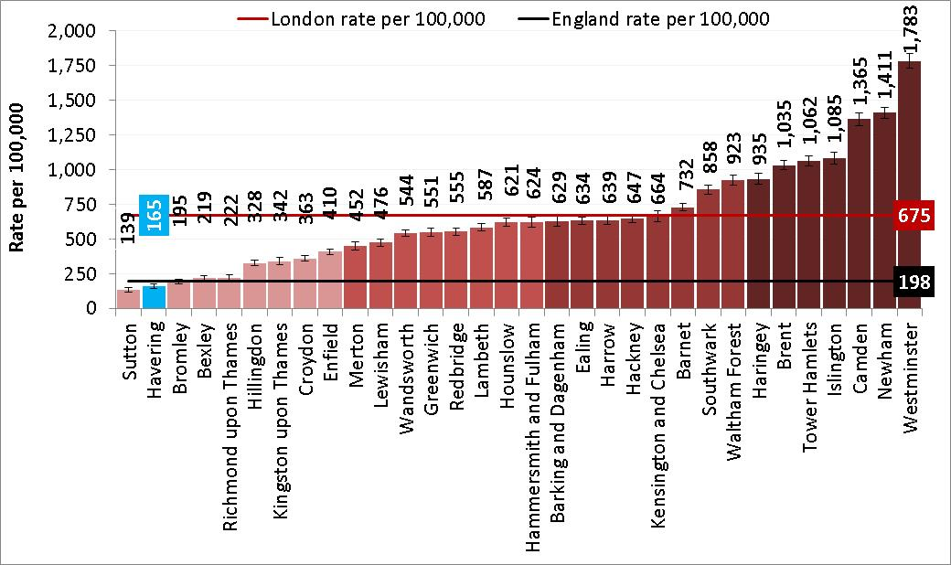
Household – Short-term Migration
Rate of short-term international migrants in Havering is 165 per 100,000 population (2nd lowest in London and significantly lower than England)
Dataset: Short-term International Migration Annual Report – Year ending mid-2016 estimates
Data Source: Office for National Statistics (ONS) - Release date: 24 May 2018
Produced by Public Health Intelligence

Slide 39
GEOGRAPHIC
PROFILE
POPULATION
PROFILE
HOUSEHOLD
PROFILE
ECONOMIC
PROFILE
- Geographical location - Havering as a place - Deprivation
- Size and structure - Population change - Ward level change - Births and migration - Projected change - Life expectancy - Ethnicity - Disabilities
- Household size - Mosaic groups - Housing tenure - Housing conditions - Homelessness - Short term migrants - Traveller population - Social isolation
- Income - Car ownership - Child poverty - Employment and unemployment

Slide 40
Economic – Summary
The average gross income per household in Havering (£44,430, as measured in 2012/13) is low in comparison to the London average (£51,770) and slightly higher than the England average of £39,557 77% of households in Havering have at least one car and compared to other local authorities in London, Havering has the second highest proportion of households (32.8%) with 2 or more cars. Majority of children in Havering are not poor, but around 8,800 live in income-deprived households. Gooshays and Heaton wards have the highest proportion of children living in poverty About 77.9% of working age residents in Havering were in employment between April 2018 and June 2018. Overall employment rate in Havering is higher than London (74.6%) and England (75.9%). The proportion of working age residents in Havering claiming out-of-work benefits* (6.8%) is significantly lower than England (8.4%)
*Main out-of-work benefits includes the groups: job seekers, ESA and incapacity benefits, lone parents and others on income related benefits.
Produced by Public Health Intelligence

Slide 41
Economic - Income
The average gross household income per household in Havering is £44,430 in 2012/13. It is lower than the London average (£51,770) and slightly higher than England (£39,557).
Dataset: Public Health Outcomes Framework
Data Source: Public Health England
Produced by Public Health Intelligence

Slide 42
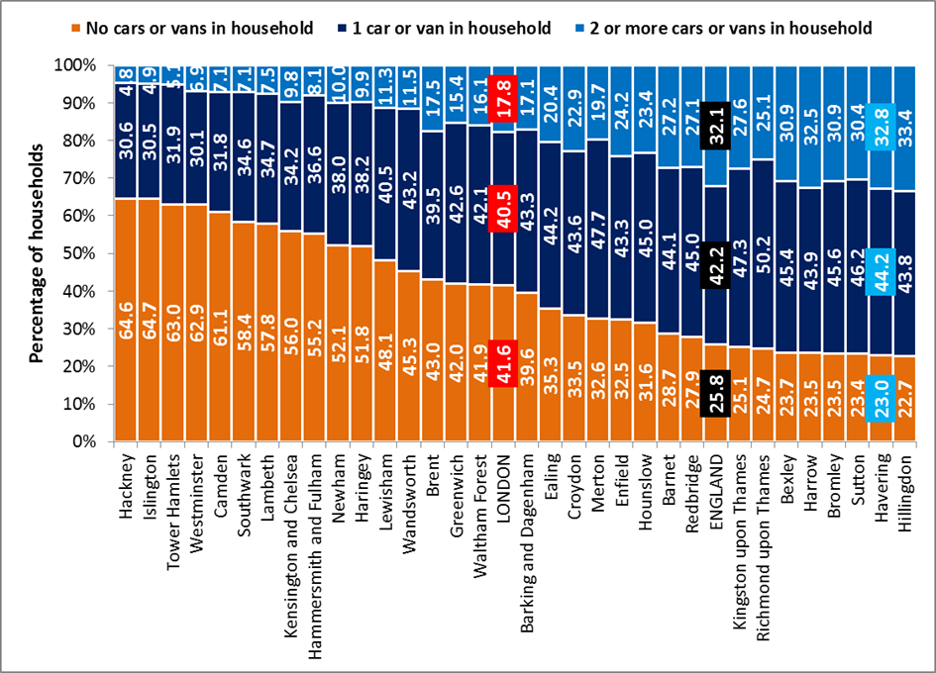
Economic – Car ownership
77% of households in Havering have at least one car and compared to other local authorities in London, Havering has the second highest proportion of households (32.8%) with 2 or more cars.
Dataset: Census 2011
Data Source: Office for National Statistics
Produced by Public Health Intelligence

Slide 43
Economic -
Child Poverty
Figure 37: Income deprivation affecting Children, quintiles within Havering LSOA, 2015
Most Deprived
More Deprived
Deprived
Less Deprived
The majority of children in Havering are not poor, but around 8,800 live in income-deprived households.
Gooshays and Heaton wards have the highest proportion of children living in poverty.
Least Deprived
Dataset: Index of Deprivation Affecting Children Index, 2015
Data Source: Department for Communities and Local Government
Produced by Public Health Intelligence

Slide 44
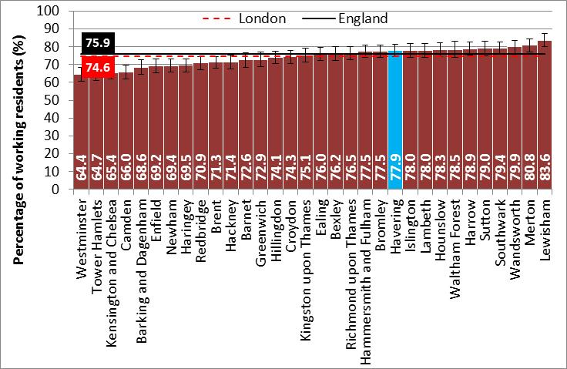
Economic Profile – Employment
77.9% of working age residents in Havering were in employment (April 2018 - June 2018 Annual household survey), the same level as London and England.
Dataset: Annual Population Survey, April 2018 - June 2018
Data Source: Office for National Statistics via NOMIS
Produced by Public Health Intelligence

Slide 45
Economic Profile – Unemployment
The proportion of working age residents in Havering claiming out-of-work benefits (6.8%) is significantly lower than England.
Dataset: Annual Population Survey, October 2016 – September 2017
Data Source: Office for National Statistics via NOMIS
Produced by Public Health Intelligence

Slide 46
Definitions 1
Child Poverty |  | measures the proportion of children living in families in receipt of out-of-work benefits or in receipt of tax credits where their reported income is less than 60 per cent median income.
Deprivation | Decile | Population ranked in order of deprivation and split into 10 groups (from most to least deprived)
 | Quintile | Population ranked in order of deprivation and split into 5 groups (from most to least deprived)
General Fertility Rate |  | defined as the number of live births in a geographic area in a year per 1000 women of childbearing age (defined as age 15 to 44 years)
Usual Resident Population |  | anyone who is resident and had stayed or intends to stay for a period of 12 months or more, OR has a permanent address and is outside the UK and intends to be outside the UK for less than 12 months.

Slide 47
Definitions 2
Life Expectancy |  | a frequently used indicator of the overall health of a population: a longer life expectancy is generally a reflection of better health. Reducing the differences in life expectancy is a key part of reducing health inequalities. Life expectancy at birth for an area is an estimate of how long, on average, babies born today may live if she or he experienced that area’s age-specific mortality rates for that time period throughout her or his life.
Migration | Internal | calculated as the difference in total between those moving into and out of the borough from other local authorities in the United Kingdom
 | International | Long-term international migrants: those coming to the United Kingdom (UK) for more than a year Short-term international migrants: those coming to the United Kingdom (UK) for less than a year
Lower layer Super Output Areas |  | are a geographic hierarchy used by Office for National Statistics (ONS) to improve the reporting of small area statistics. They are built from groups of contiguous Output Areas and have been automatically generated to be as consistent in population size as possible, and typically contain from four to six Output Areas. The minimum population is 1000 and the mean is 1500

Slide 48
Definitions 3
Statutory Homelessness (Eligible people not in priority need) | This indicator demonstrates the number of households that have presented themselves to their local authority but under homelessness legislation have been deemed to be not in priority need. The majority of the people that full under this cohort are single homeless people. Households and individuals that are eligible but not in priority need or are in temporary accommodation can have greater public health needs than the population as a whole. Count of households who are eligible homeless people but deemed to be not in priority need under part VII of the Housing Act 1996 or part III of the Housing Act 1985.. People who fall under this criteria must still be provided with advice and assistance in securing their own accommodation.
Households in temporary accommodation | These data demonstrate the number of homeless households in temporary accommodation awaiting a settled home.
² (Definition from Department of Communities and Local Government)

